Slide 1

TCS iON RIO | Retail Sales Forecasting System
Predictive Analytics for Inventory Optimization
200,000 Records | 4-Year Historical Analysis | ML-Powered Predictions

Slide 2

Addressing Critical Retail Challenges
The Inventory Dilemma
Demand Volatility
Overstocking: High holding costs & product wastage
Seasonal demand variations are hard to predict.
Product performance varies across periods.
Understocking: Lost sales & customer dissatisfaction
Complex cost-demand relationships
Our Objective: To build a comprehensive forecasting system that accurately predicts product demand, enabling data-driven inventory management and strategic business decisions.

Slide 3

Robust Dataset for Predictive Power
Dataset Specifications
Key Data Fields
Size: 200,000 records
Product_Name: Unique identifiers
Time Span: 2020-2023 (4 years)
Cost: ₹152 - ₹194,498
Products: 6,000 unique products
Year/Month: Temporal dimensions
Categories: 15 diverse categories
Monthly_Sales: 38-3,596 units
Data Quality: 100% complete, 0 missing values

Slide 4

Methodology: A Systematic 6-Phase Approach
1
2
Data Generation
Data Cleaning & Sanitization
Synthetic data with realistic patterns & seasonal multipliers.
Quality checks, duplicate detection, outlier analysis.
3
4
Exploratory Data Analysis
Feature Engineering
Temporal patterns, product performance, correlation studies.
12+ new predictive features: time series, growth rates, volatility.
5
6
Model Development
2024 Forecasting
Linear Regression, Random Forest, Gradient Boosting tested with time-based split.
Future predictions with confidence intervals & risk assessment.

Slide 5

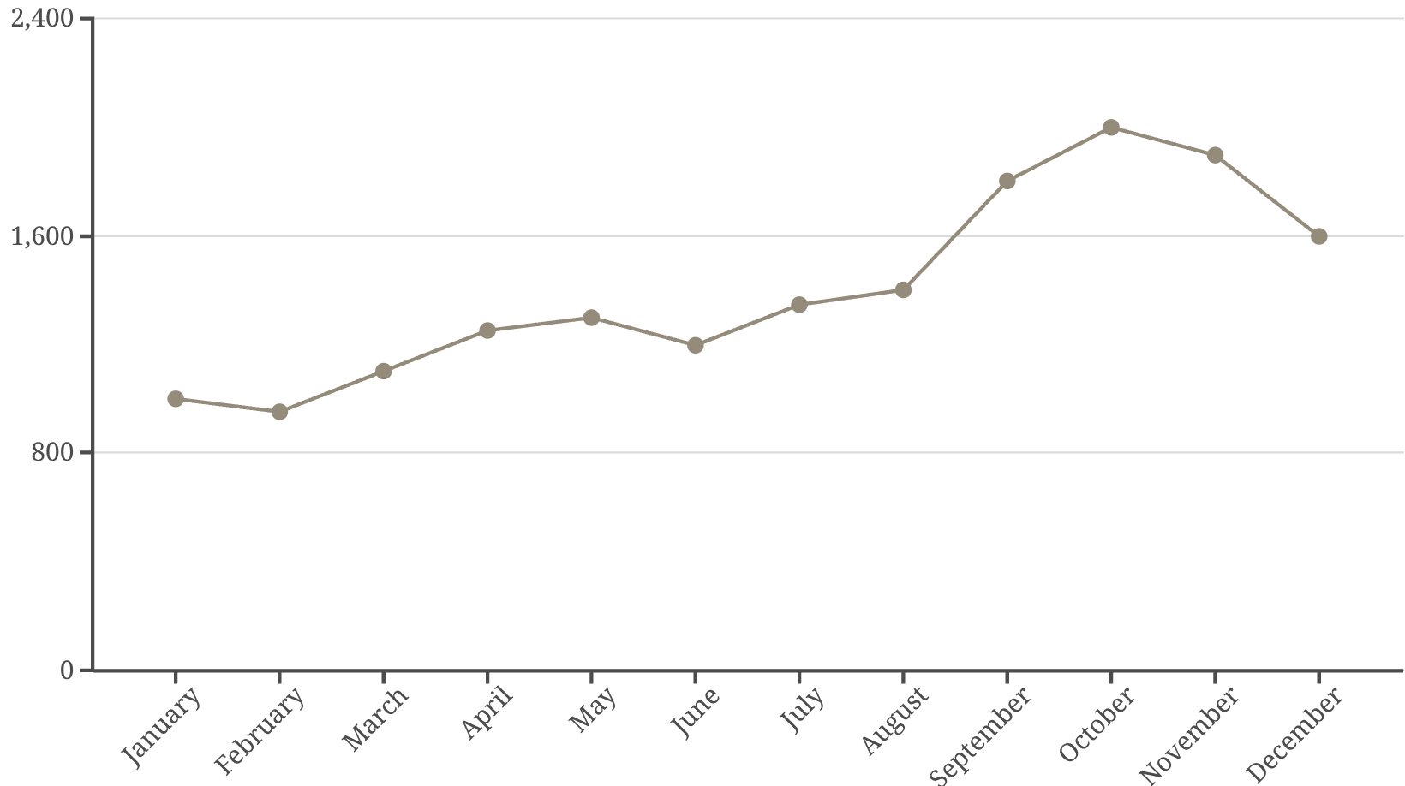
Key Insights from Exploratory Data Analysis
Temporal Patterns
Peak Season: September-November (Festival season)
Low Season: January-February (Post-holiday dip)
Growth Trend: Consistent year-over-year growth
Product Performance
Top Categories: Grocery, Automotive, Electronics
High Performers: Health & Wellness, Clothing
Seasonal Products: Toys (Dec), Sports (Summer)
Low correlation (0.0341) between cost and sales indicates price is not the primary driver. Indian retail patterns are clearly visible, with 60-100% sales spikes during festival months.

Slide 6

Model Performance: Gradient Boosting Leads the Way
Training Strategy: Time-based split (2020-2022 Training, 2023 Testing) with 150,962 training and 49,038 test records.
Model
R² Score
MAE
MAPE
Linear Regression
0.661
725.7
47.6%
Random Forest
0.992
15.4
1.3%
Gradient Boosting
0.994
27.4
3.4%
Winner: Gradient Boosting, explaining 99.41% of variance. Exceptional accuracy for retail forecasting needs.

Slide 7

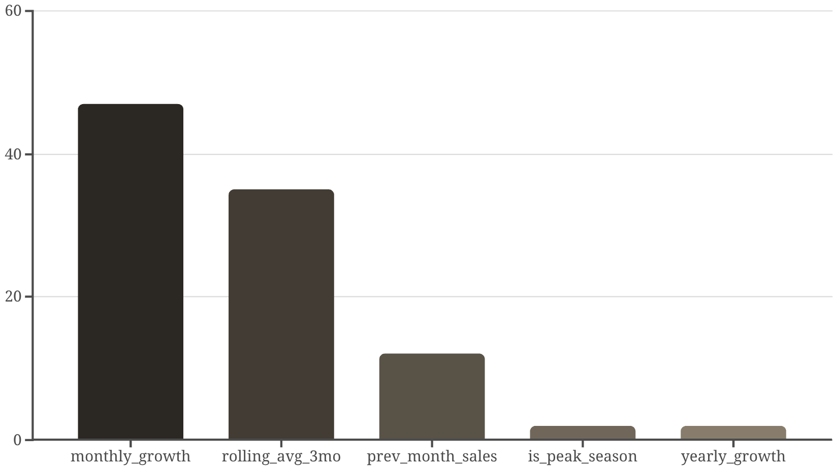
Feature Importance: Understanding Sales Drivers
Model Intelligence at Work
Captures both short-term momentum and long-term trends.
Learns seasonal patterns automatically.
Recognizes product-specific behaviors.
Effectively models growth trajectories.
Business Interpretation: Recent performance (monthly growth, 3-month average) is the strongest predictor, providing robust trend and momentum insights.

Slide 8

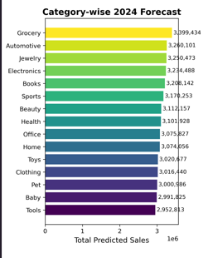
2024 Forecast Summary: Strategic Outlook
Annual & Monthly Projections
Top Categories 2024: Grocery (3.30M), Automotive (3.26M), Jewelry (3.25M)
Total Annual Forecast: 46.87 million units
Average Monthly Sales: 651 units per product
Confidence Level: 95% intervals provided
Risk Assessment by Product Count
Low Risk: 33% (23,760 products)
Medium Risk: 34% (24,480 products)
High Risk: 33% (23,760 products)

Slide 9

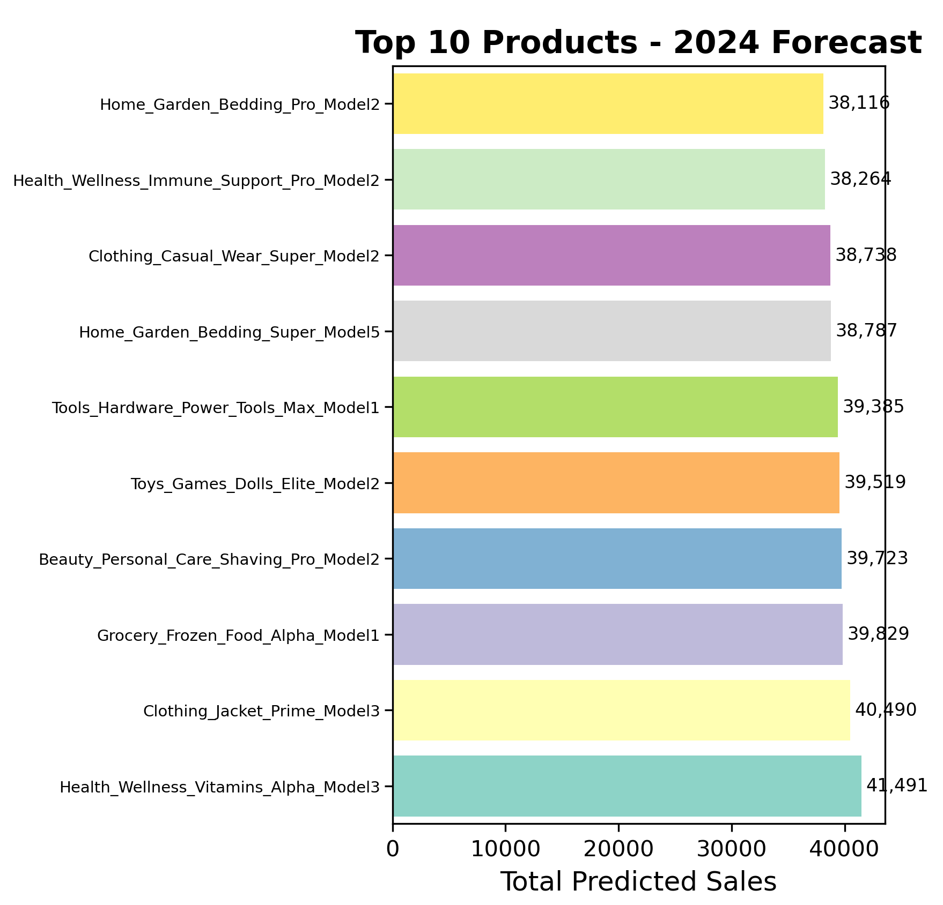
Top 10 Product Forecasts for 2024
Key Insights: Health & Wellness products dominate, alongside a diverse mix from other categories. Premium variants (Alpha, Prime, Pro) show consistent high performance, indicating strong consumer preference.

Slide 10

Strategic Recommendations for Business Impact
1
2
Inventory Optimization
Procurement Planning
Increase stock by 60-100% Sep-Nov peak.
Advance orders by July for festivals.
Reduce by 15-20% Jan-Feb low season.
Just-in-time for low season.
Focus on Health, Grocery, Automotive.
Prioritize premium product variants.
3
4
Marketing Strategy
Risk Mitigation & Monitoring
Intensify campaigns during Sep-Nov peak.
Monitor 33% high-risk products.
Promote health & wellness products.
Maintain safety stock for top performers.
Target winter clothing & gifts in Nov-Dec.
Compare actual vs. predicted sales monthly.

Slide 11

MODEL VALIDATION
Accuracy & Reliability
Validation Methodology
Accuracy Metrics
Time-series cross-validation
R² Score: 0.9941 (99.41% variance explained)
Out-of-sample testing (2023 data)
Mean Absolute Error: 27.4 units
Business logic constraints applied
Mean Absolute Percentage Error: 3.44%
Root Mean Square Error: 43.03 units
Model Reliability
Statistical Significance
Predictions within ±3.44% of actual values. Confidence intervals at 95% level provided. Risk categories validated against volatility. Seasonal patterns captured accurately.
All predictions statistically significant. Model performance stable across categories. Consistent accuracy across time periods. Business constraints successfully applied.

Slide 12


TECHNICAL FOUNDATION
Robust Implementation
Technology Stack
Key Technical Features
Python: Core development language
Feature Engineering: 12+ engineered features
Libraries: pandas, scikit-learn, matplotlib, seaborn
Time Series Handling: Proper temporal validation
Models: Gradient Boosting, Random Forest, Linear Regression
Scalability: Handles 200K+ records efficiently
Reproducibility: Fixed random seeds, version control
Environment: Jupyter Notebook
Code Quality
Deliverables
Modular, well-documented. Comprehensive error handling. Performance optimizations. Professional development practices.
Complete Jupyter notebook. CSV datasets at each stage. Model performance reports. Visualization charts. GitHub repository with full code.

Slide 13

PROJECT IMPACT
Delivering Business Value
Business Value
Quantified Benefits
Cost Savings: Reduced overstocking & understocking
99.41% forecast accuracy for confident planning
Revenue Growth: Optimized inventory levels
3.44% error rate minimizes miscalculations
Risk Reduction: Proactive demand planning
Seasonal insights prevent stock-outs
Efficiency Gains: Automated forecasting
Risk assessment identifies products needing attention
Strategic Advantages
Learning Outcomes
Data-driven decision making. Competitive advantage. Scalable solution for growth. Foundation for advanced analytics.
End-to-end data science execution. Advanced ML implementation. Business problem solving. Professional communication.

Slide 14

FUTURE ROADMAP
Enhancing Capabilities
Immediate Improvements
Advanced Features
Real-time data integration
Deep learning models (LSTM, GRU)
Automated model retraining pipeline
External data integration (weather, events, economic indicators)
Interactive dashboard development
Mobile application for managers
Multi-location forecasting
Dynamic pricing optimization
Scalability Enhancements
Business Extensions
Cloud deployment (AWS/Azure). Big data processing. API development for integration. Multi-tenant architecture.
Customer segmentation. Promotion impact analysis. Supply chain optimization. Competitive intelligence.

Slide 15

CONCLUSION
Key Achievements
✓ Comprehensive 200K-record retail dataset generated
✓ 99.41% accurate forecasting model developed
✓ Seasonal patterns and business insights identified
✓ 2024 predictions with confidence intervals delivered
✓ Risk assessment and business recommendations provided
Project Success Metrics
All objectives achieved. Professional-grade implementation. Business-ready insights. Scalable and maintainable.
Thank You for Your Attention!
GitHub Repository: https://github.com/hemantborana/TCS-iON-RIO-Retail-Sales-Forecasting
LinkedIn: https://www.linkedin.com/in/hemant-parasmal-borana-17a742289
Email: hemantpb123@gmail.com

